Slide 1
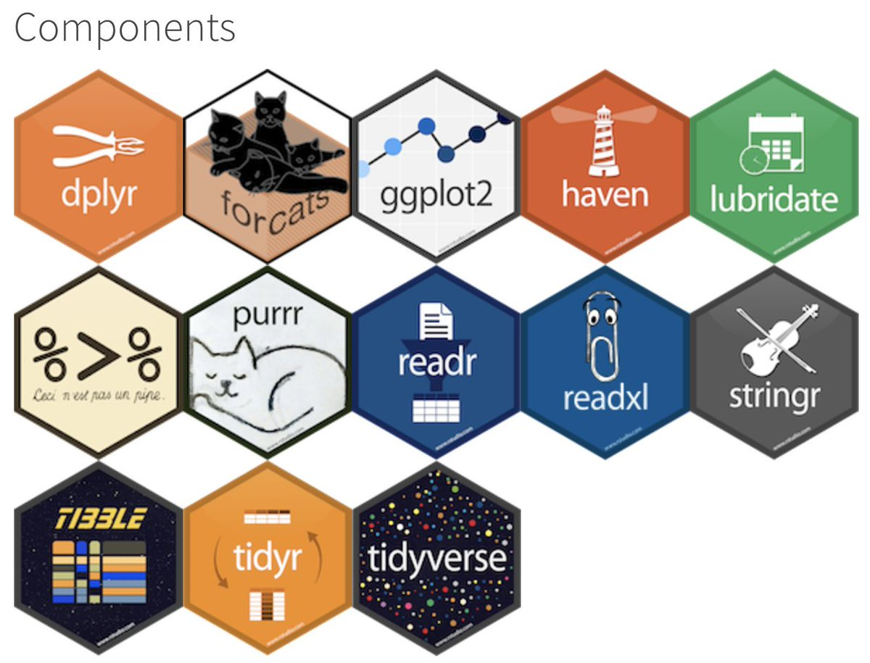
Data wrangling! Introduction to the Tidyverse
Daniel Padfield

Slide 2
What is the tidyverse?
Set of packages designed by Hadley Wickham and his team at Rstudio
Try to create a set of tools for full-stack analysis that use the same syntax and set of rules
Install the complete tidyverse using:
install.packages(“tidyverse”)

Slide 3
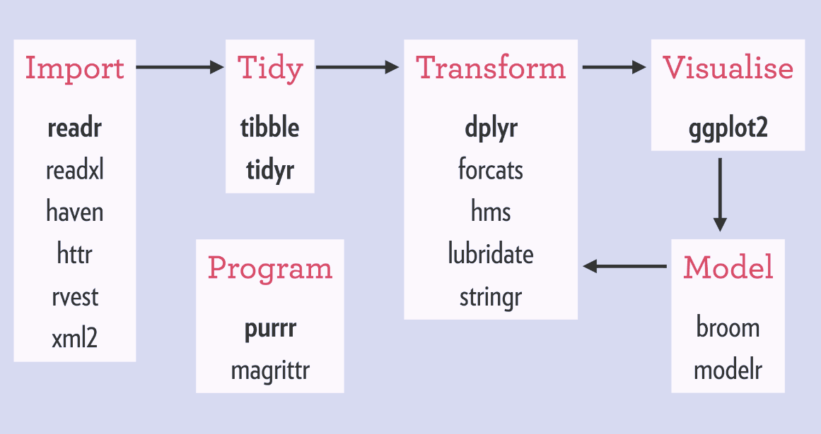
What is the tidyverse?
Can do almost all my programming with the same set of packages
Makes my code more readable so future me can understand
In general, drops the need for $ and “ ”
Great documentation and support online

Slide 4
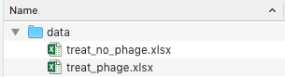
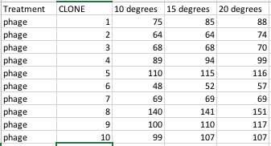
Read in files with purrr and readxl
read_excel() handles excel files
map_df() takes a vector a vector of file names and returns a dataframe
treat_phage.xlsx

Slide 5
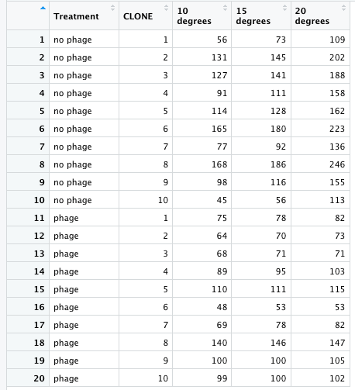
Read in files with purrr and readxl
# list files
files <- list.files('data', full.names = TRUE)
# read in many files using map() and read_excel()
d <- map_df(files, read_excel)

Slide 6
Tidy column names with janitor
Writing code, odd column names can often be confusing
No CAPITALS, numbers as first letter or spaces
janitor::clean_names() automatically renames columns to be all lower case and replaces spaces with “_”, puts an X in front of the first number
Can do one at a time using:
dplyr::rename(d, new_column_name = old_column name)

Slide 7
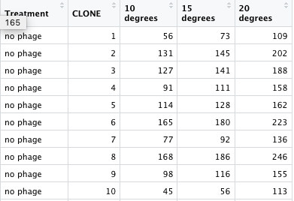
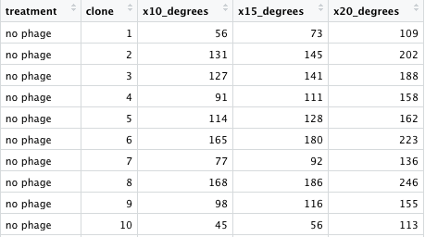
Tidy column names with janitor
# change column names with janitor
d <- clean_names(d)
# or a single column with rename
d <- rename(d, clone = CLONE)
From this…
To this…

Slide 8
Stack data (i.e. long format) using gather()
Lots of packages (ggplot2, lme4 etc) need data to be in long format
tidyr::gather() combines multiple columns into key value pairs
Similar to reshape2::melt()

Slide 9
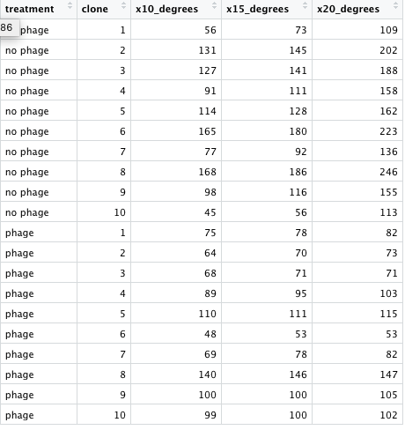
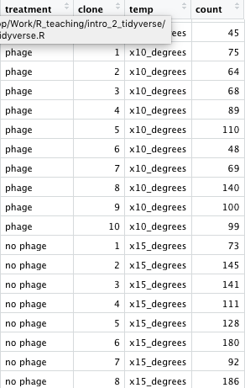
Stack data (i.e. long format) using gather()
# convert data to long format using gather
d <- gather(d, key = ‘temp’,
value = ‘count’,
contains(‘degree’))
From this…
To this…

Slide 10
Select columns with select()
Can select or deselect columns
Via position
select(d, c(1,3,4))
Via name
select(d, c(clone, treatment, temp, count))
Drop columns
select(d, -c(clone, treatment))
Helper functions
select(d, c(clone, everything()))
select(d, starts_with(‘t’))
?select_helpers for all functions

Slide 11
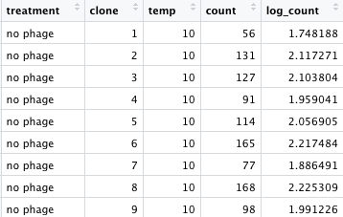
Add columns with mutate()
Create new columns with mutate()
# change and add columns
d <- mutate(d, temp = readr::parse_number(temp),
temp = as.numeric(temp),
log_count = log10(count))

Slide 12
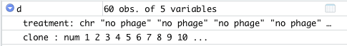
Do the same function on many columns using mutate_at()
Do the same function on multiple columns using mutate_at()
Change character or numeric columns to a factor
# change multiple columns using mutate_at()
d <- mutate_at(d, c('treatment', 'clone'), as.factor)

Slide 13
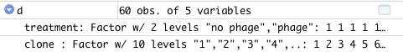
Do the same function on many columns using mutate_at()
Do the same function on multiple columns using mutate_at()
Change character or numeric columns to a factor
# change multiple columns using mutate_at()
d <- mutate_at(d, c('treatment', 'clone'), as.factor)

Slide 14
No more nested ifelse() with case_when()
Different dilution factors
10 ºC = 10⁻⁵, 15 ºC = 10⁻⁴, 20 ºC = 10⁻⁶
Different bacteria
Clones 1-5 = LacZ, Clones 6-10 = wild type
Common to want to add columns based on other conditions

Slide 15
No more nested ifelse() with case_when()
Different dilution factors
10 ºC = 10⁻⁵, 15 ºC = 10⁻⁴, 20 ºC = 10⁻⁶
Different bacteria
Clones 1-5 = LacZ, Clones 6-10 = wild type
# using ifelse() and mutate()
d <- mutate(d, type = ifelse(clone <= 5, 'lacz', 'wt’),
df = ifelse(temp == 10, 10^-5,
ifelse(temp == 15, 10^-4,
10^-6)))

Slide 16
No more nested ifelse() with case_when()
Different dilution factors
10 ºC = 10⁻⁴, 15 ºC = 10⁻⁵, 20 ºC = 10⁻⁶
Different bacteria
Clones 1-5 = LacZ, Clones 6-10 = wild type
# using ifelse() and mutate()
d <- mutate(d, type = ifelse(clone <= 5, 'lacz', 'wt’),
df = ifelse(temp == 10, 10^-4,
ifelse(temp == 15, 10^-5,
10^-6)))
# using case_when() and mutate()
d <- mutate(d, type = ifelse(clone <= 5, 'lacz', 'wt’),
df = case_when(temp == 10 ~ 10^-4,
temp == 15 ~ 10^-5, temp == 20 ~ 10^-6))

Slide 17
Subset rows with filter()
Similar to subset()
removes rows of a dataframe based on a condition
# examples of using filter
# keep just 15 and 20 degrees
filter(d, temp > 10)
# keep just 10 degrees LacZ
filter(d, temp == 10 & type == ‘lacz’)

Slide 18
Piping with %>%
Read a pipe as “and then”
Allows your code to be read like a recipe
Removes the need to constantly re-assign objects
The “.” operator acts as an indicator for whatever is coming from the left hand side of the pipe

Slide 19
Put it all together! Pipe example!
# Example of using pipes %>%
d <- list.files('data', full.names = TRUE) %>%
map_df(., read_excel) %>%
clean_names(.) %>%
gather(., key = 'temp', value = 'count’,
contains('degree')) %>%
mutate(., temp = readr::parse_number(temp),
temp = as.numeric(temp),
log_count = log10(count)) %>%
mutate_at(., c('treatment', 'clone’),
as.factor) %>%
…
# The recipe version
d <- list all the files in the “data” directory (and then)
read them into a dataframe (and then)
change their names (and then)
make the data long format (and then)
add a bunch of columns (and then)
do the same function to treatment and clone …

Slide 20
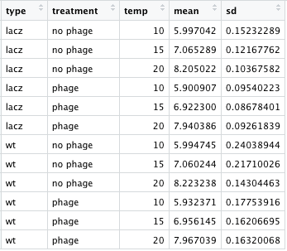
Summary data using group_by() and summarise()
Get summary stats based on groupings of your data
summarise() - get means and standard deviations, or anything that returns a single value (i.e. max, min, number of rows, mode, median)
# get summary data
d_means <- group_by(d, type, treatment, temp) %>%
summarise(mean = mean(log_count),
sd = sd(log_count)) %>%
ungroup()

Slide 21
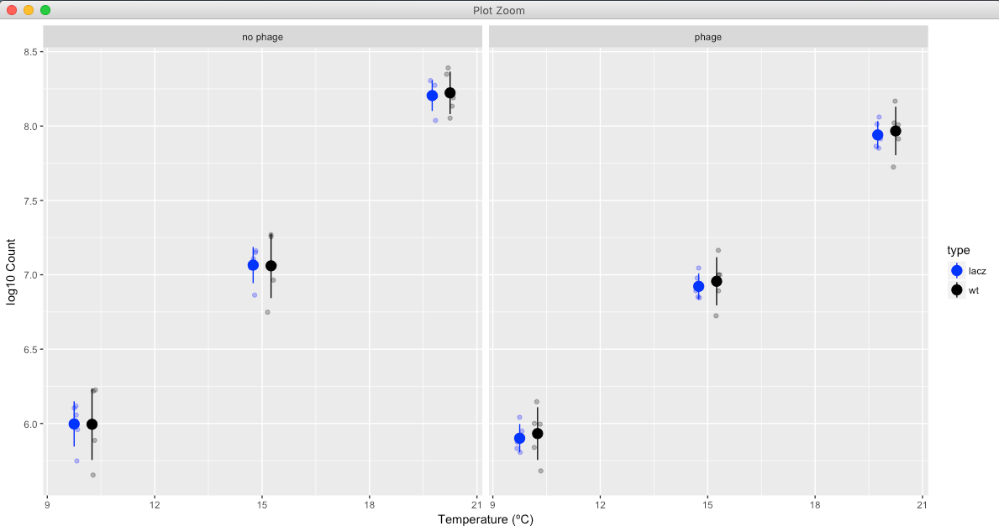
Plot with ggplot2
Plot summary data with raw data
# plot with ggplot2
ggplot() +
geom_linerange(aes(x = temp, ymin = mean - sd, ymax = mean + sd, col = type, group = type), d_means, position = position_dodge(width = 1)) +
geom_point(aes(temp, mean, col = type), d_means, size = 4, position = position_dodge(width = 1)) +
geom_point(aes(temp, log_count, col = type), position = position_jitterdodge(dodge.width = 1, jitter.width = 0.2), alpha = 0.3, d) +
facet_wrap(~ treatment) +
scale_color_manual(values = c('blue', 'black')) +
ylab('log10 Count') +
xlab('Temperature (ºC)')

Slide 22
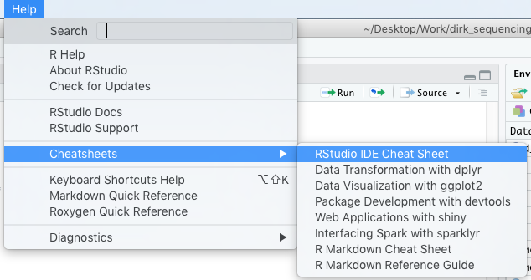
Cheatsheets for the tidyverse

Slide 23
Cheatsheets for the tidyverse

Slide 24
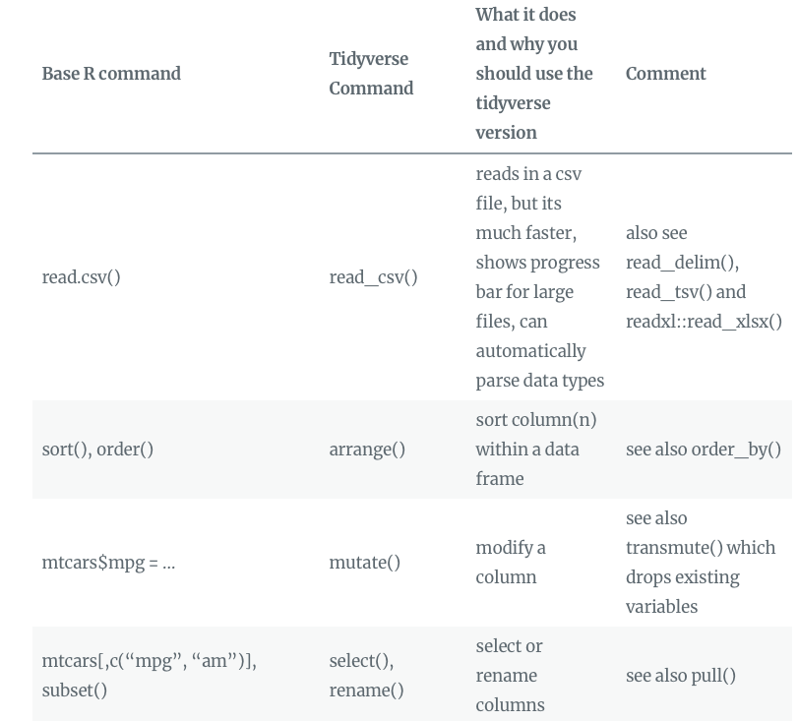
Moving from base R to the tidyverse
Blog post link!

Slide 25
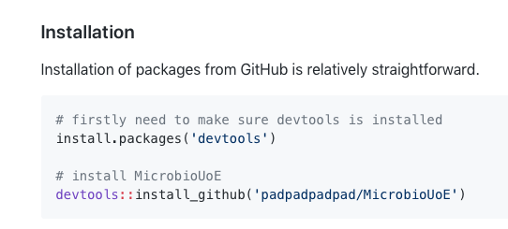
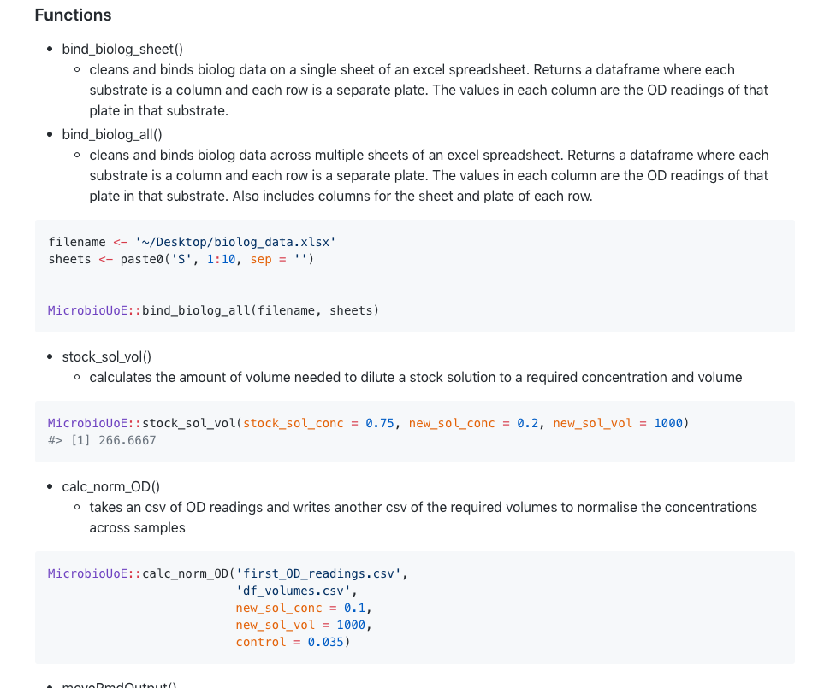
MicrobioUoE
Set of functions I commonly use, wrote into a package

Slide 26
Cheers!

